Slide 1
The Value of Article 6
Sha Yu, Ryna Cui, Stephanie Waldhoff, Sonny Kim, Jae Edmonds
Joint Global Change Research Institute

Slide 2
How Valuable is Article 6?
What is the potential economic value of implementing Article 6?
What is the potential size of the carbon market?
Who would be the sellers and who would be the buyers?
How much could costs be reduced?
How much additional ambition could be enabled?
Source: https://unfccc.int/files/focus/long-term_strategies/application/pdf/mid_century_strategy_report-final_red.pdf

Slide 3
How Valuable is Article 6?
Article 6 holds significant potential to reduce cost and enhance ambition
  2030 ~$250 billion 2015 US$
Some countries would benefit more, but everyone could be better off through collaboration.
If we interpret the cost of achieving each country’s NDC as a willingness to pay, 5 GtCO₂/year additional mitigation could be enabled in 2030.
Realizing this potential is a real-world challenge
  Near-term: Translating NDCs to Internationally Transferred Mitigation Outcomes (ITMOs); Writing the rules to preserve emissions mitigation—do no harm. (Ensuring that no “hot air” is created.)
  Long-term: It could take any number of forms including NDC coalitions, ratchet mechanisms, or other novel approaches.

Slide 4
Approach
We used the Global Change Assessment Model (GCAM)
  A state of the art integrated assessment model of economy, energy, land, water and climate
  Used by the IPCC to develop scenarios
Nationally Determined Contributions (NDCs)
  Taken from country submissions
  Post-2030 projections extend trends
  Used the same method as in the Fawcett, et al. (2015) Science paper
LAC
Africa
Middle East
India
Southeast Asia
China
Europe
U.S.
DRAFT PRESENTATION—DO NOT QUOTE, SUBJECT TO CHANGE

Slide 5
NDC Emissions: Independent Implementation
Significant decline in emissions
The level of emissions reduction varies by country
LAC
Africa
Middle East
India
Southeast Asia
China
U.S. 2015 Commitment
Europe
U.S.
DRAFT PRESENTATION—DO NOT QUOTE, SUBJECT TO CHANGE

Slide 6
NDC Shadow Prices: Independent Implementation
EU-15
$209/tonCO₂
Wide range in shadow prices
 | 2030 | 2050 | 2100
I-NDC Range | $0 to $101/tonCO₂ | $0 to $111/tonCO₂ | $16 to $209/tonCO₂
$0/tonCO₂
DRAFT PRESENTATION—DO NOT QUOTE, SUBJECT TO CHANGE

Slide 7
Reducing Cost

Slide 8
NDC Shadow Prices: Independent vs. Joint Implementation
Joint implementation shadow price lies between high and low prices of independent implementation
 | 2030 | 2050 | 2100
I-NDC Range | $0 to $101/tonCO₂ | $0 to $111/tonCO₂ | $16 to $209/tonCO₂
J-NDC | $38/tonCO₂ | $52/tonCO₂ | $107/tonCO₂
DRAFT PRESENTATION—DO NOT QUOTE, SUBJECT TO CHANGE

Slide 9
Potential changes in emissions—CO₂
Seller (11 regions)
Buyer (4 regions)
Seller to buyer
(15 regions)
Buyer to seller
(2 regions)
Sellers
Middle East
India
China
Southeast Asia
U.S.
Europe
China
Buyers
DRAFT PRESENTATION—DO NOT QUOTE, SUBJECT TO CHANGE

Slide 10
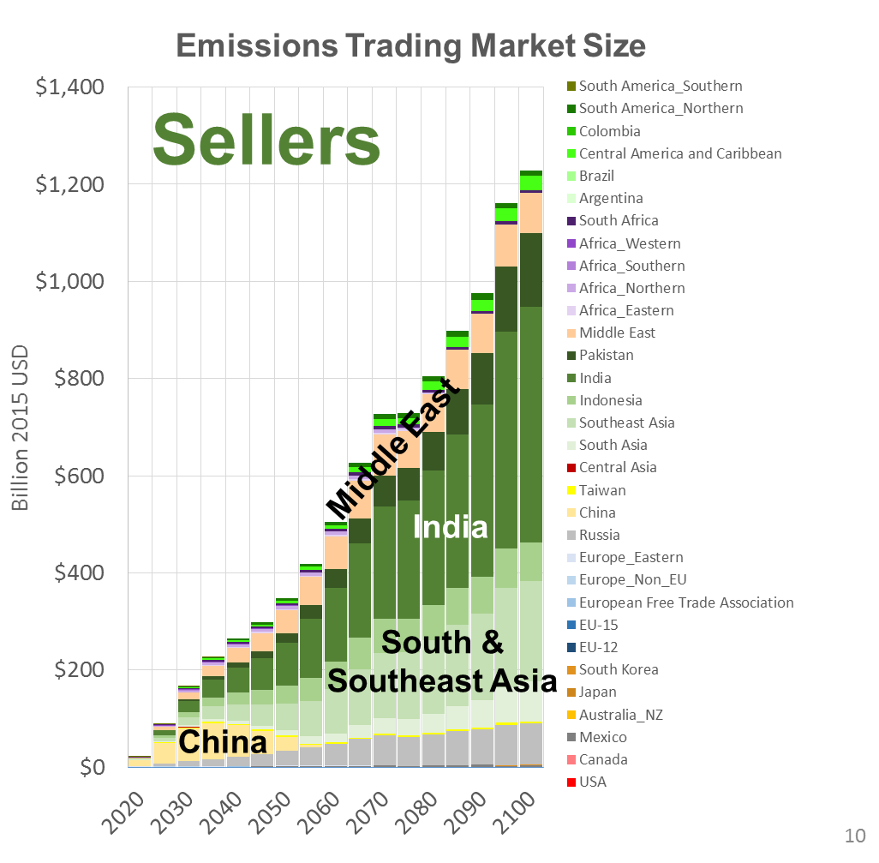
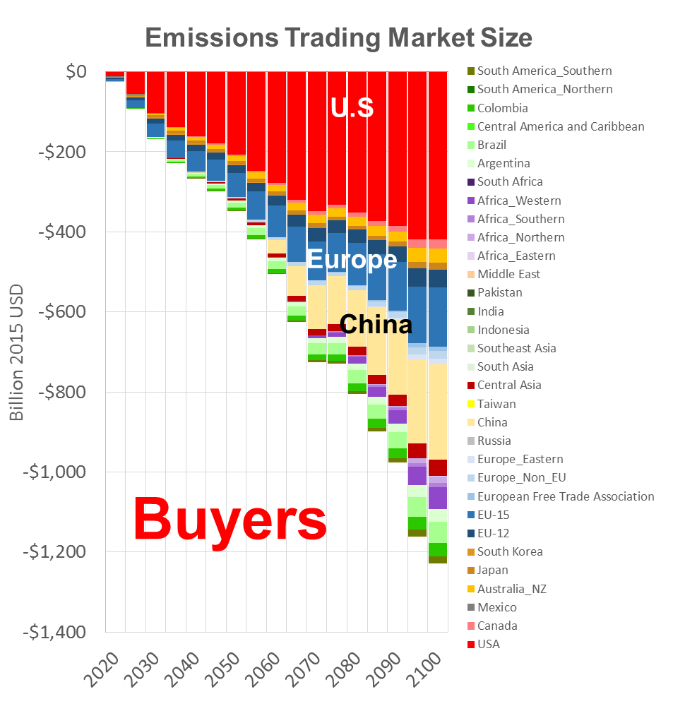
Potential Market Size—Billion of 2015 US$
Year | Market Size (Billion 2015 US$)
2030 | $167
2050 | $347
2100 | $1,229
DRAFT PRESENTATION—DO NOT QUOTE, SUBJECT TO CHANGE

Slide 11
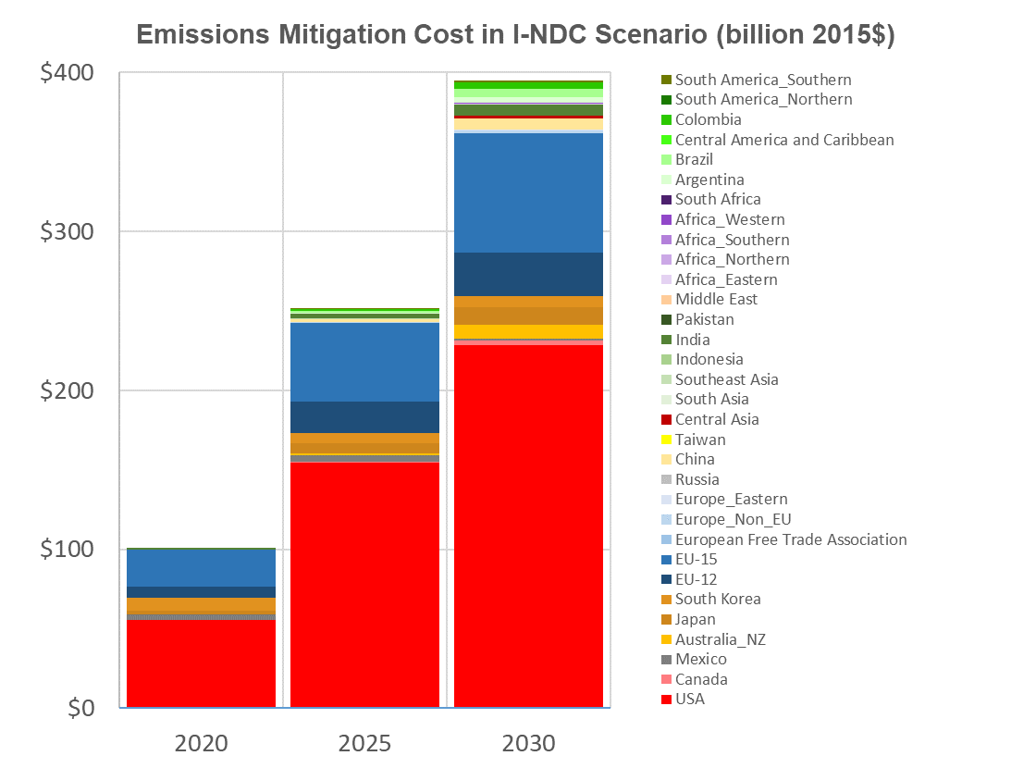
Potential Cost Reductions

Slide 12
Enhancing Ambition

Slide 13
Potential Enhanced Ambition
Interpret the cost of achieving each country’s NDC as a willingness to pay.
Apply each country’s savings from employing Article 6 to jointly achieving additional mitigation.
Total cost will be the same as in the I-NDC scenario
Emissions mitigation will increase.

Slide 14
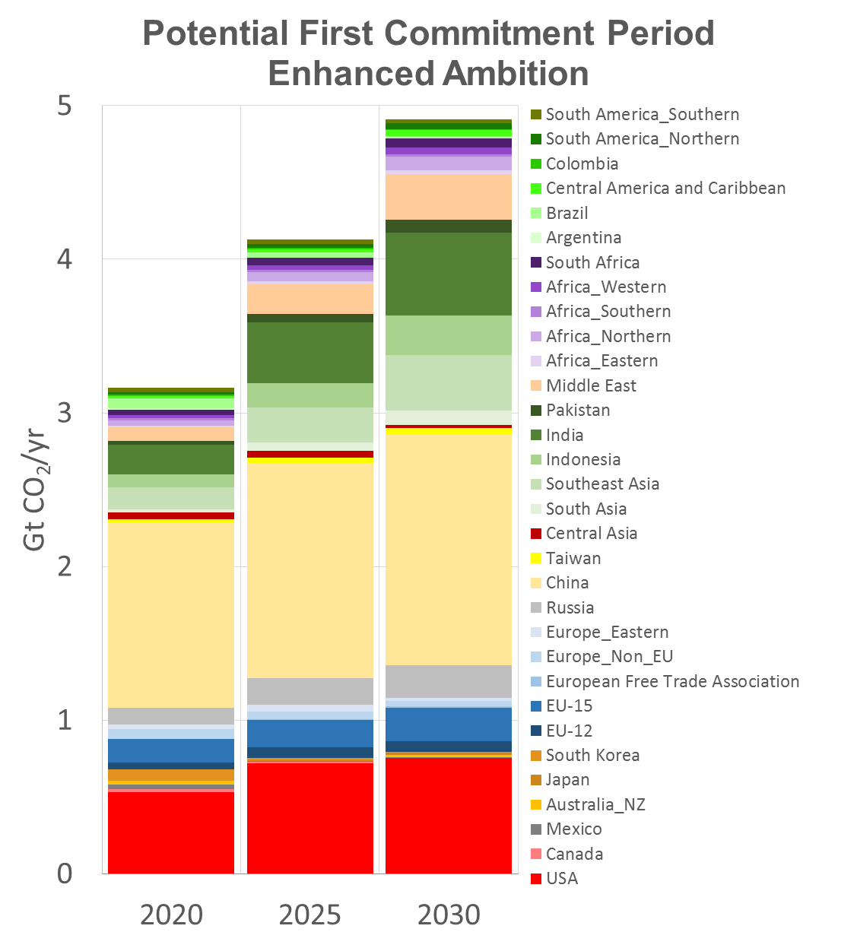
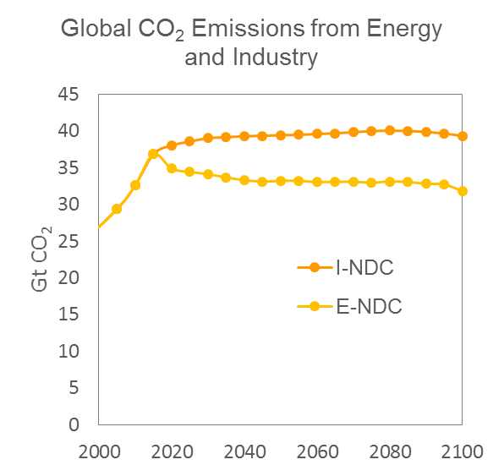
Enhanced Ambition Enabled by Article 6

Slide 15
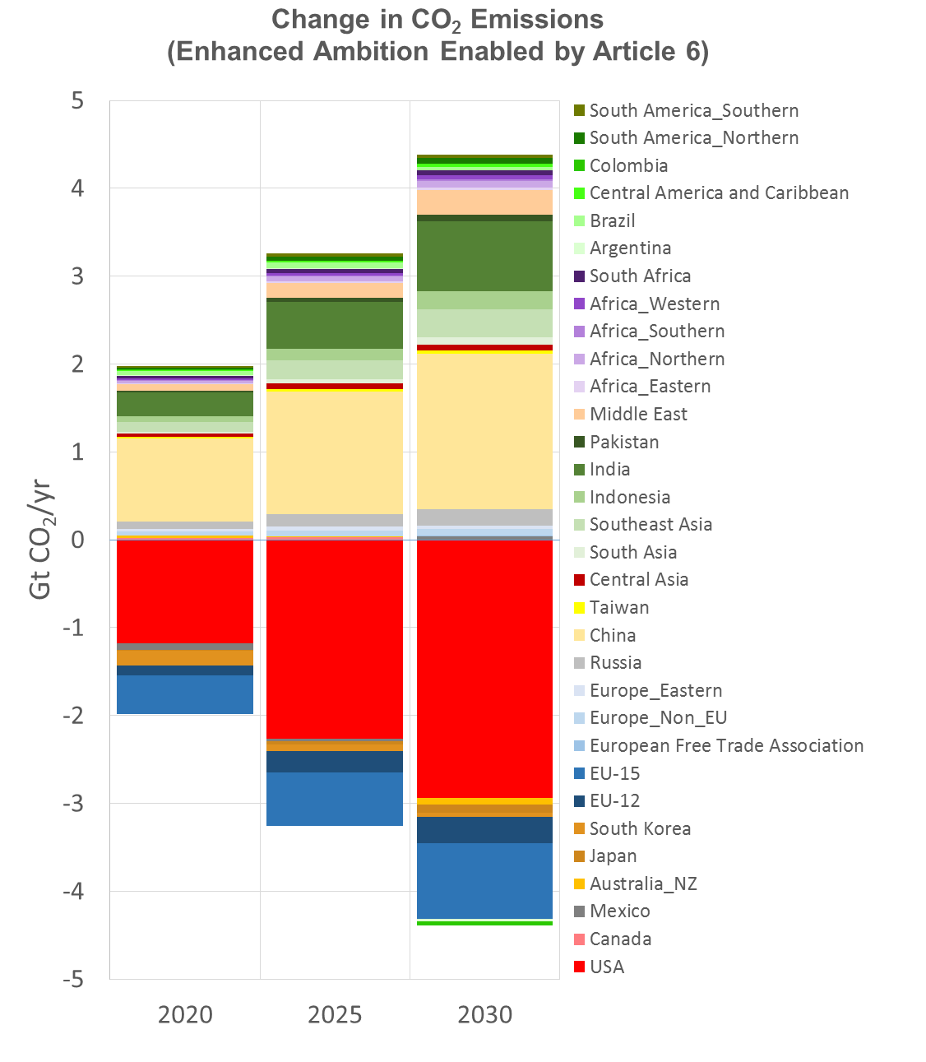
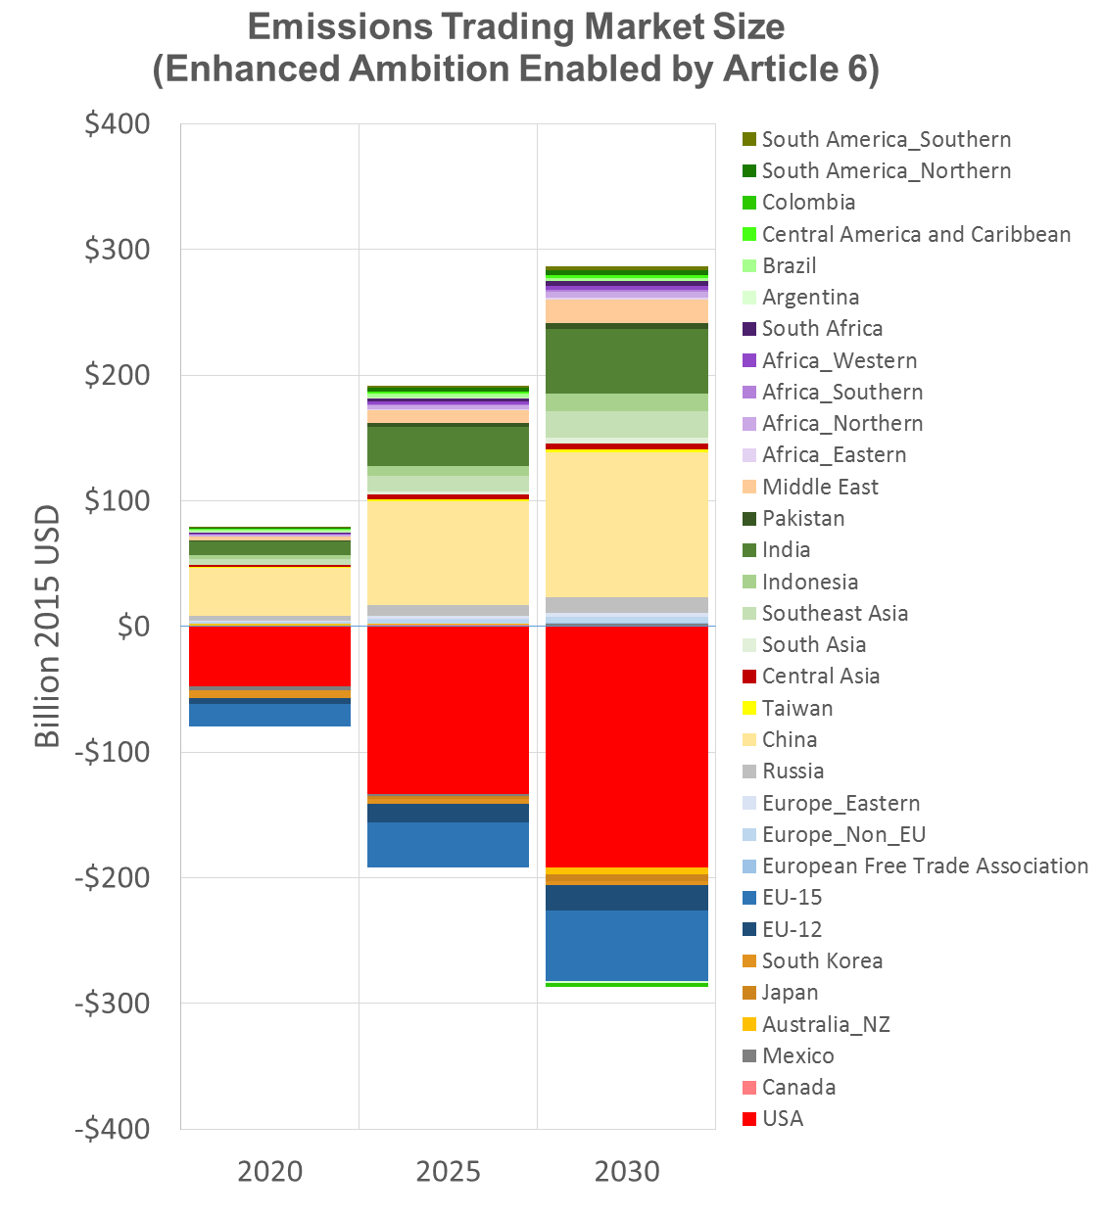
Potential Market Size with Enhanced Ambition
Financial Transactions with Enhanced Ambition
(Buyers (-) and Sellers(+))
Physical Trades with Enhanced Ambition
(Buyers (-) and Sellers(+))

Slide 16
How Valuable is Article 6?
Article 6 holds significant potential to reduce cost and enhance ambition
Everyone could be better off through collaboration
Estimated potential
  2030 ~$250 billion 2015 US$
  2050 ~$350 billion 2015 US$
  2100 ~$990 billion 2015 US$
Mitigation could be enhanced by 5GtCO₂/year in 2030
Source: https://unfccc.int/files/focus/long-term_strategies/application/pdf/mid_century_strategy_report-final_red.pdf

Slide 17
The Challenges
Near-term challenges:
  How to translate heterogeneous NDCs into Internationally Transferred Mitigation Outcomes (ITMOs)?
  Ensure that rules prevent “hot air”
    Calvin, et al. showed that seemingly air-tight rules for CDM-types of emissions trading can have perverse macro-outcomes.
  Can clubs collaborate to extract the benefits without a formal trading regime?
Longer-term challenges:
  How to create incentives to increase ambition?
  Can dynamic incentives be developed to increase ambition?
Source: https://www.ieta.org/resources/Resources/Position_Papers/2016/IETA_Article_6_Implementation_Paper_May2016.pdf

Slide 18
DISCUSSION

