Slide 1

Keeping to 1.5 degrees
How markets and Europe must lead on Paris
First European Climate Summit – Lisbon, 16 April 2019

Slide 2
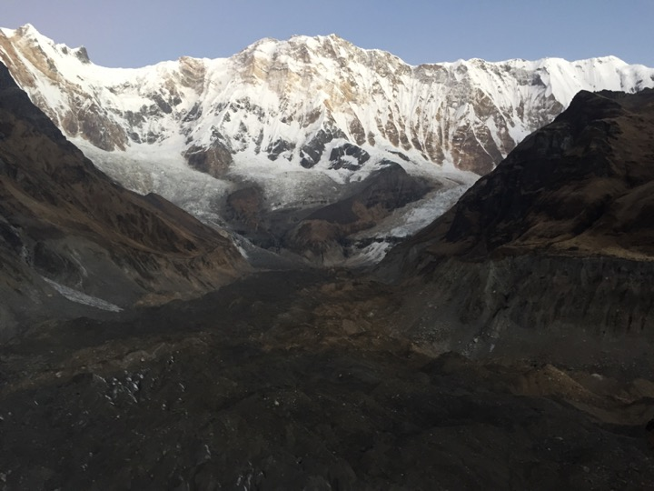

Slide 3
